Slide 1
Developmentally Supportive Care
Dr. Suman Rao PN MD, DM
Prof & Head
Dept. of Neonatology
St. John's Medical College Hospital
Bangalore

Slide 2
Learning objectives:
What is DSC?
Need for DSC
Components of DSC
Methods of DSC

Slide 3
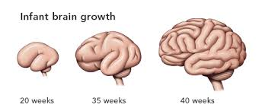
Brain growth – Ex utero!
Migration
Neurogenesis
Arborisation
Synaptogenesis
Myelination
Programmed cell death
Competitive elimination
0 10 20 30 40w 6m 2y 10y 60y
Birth

Slide 4
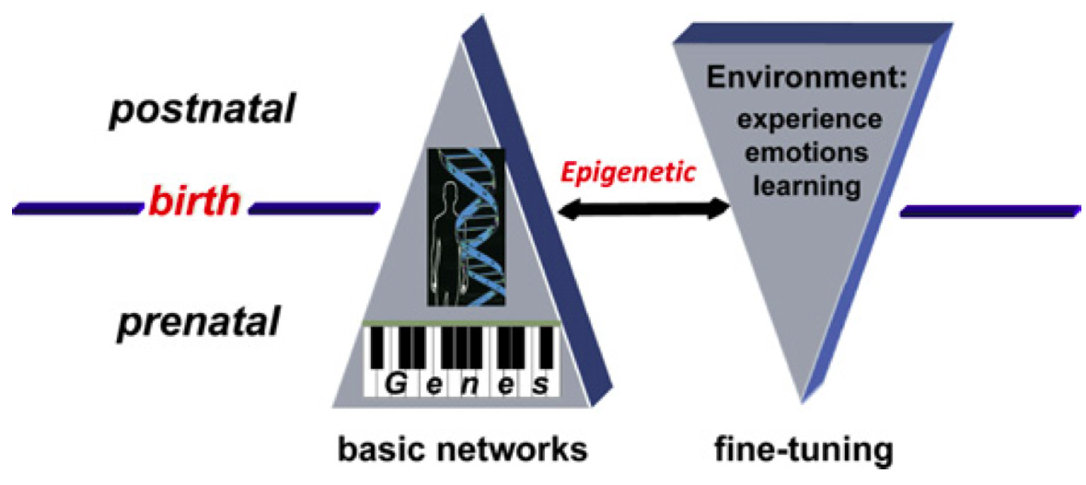
Brain – Experience Expectant
Experience Dependent

Slide 5
Neonatal Sensory Systems
Tactile (touch) → vestibular → gustatory (taste)-olfactory (smell) → auditory (hearing) → visual (sight)
Stimulation of early maturing senses has + influence on late maturing senses.
Untimely stimulation within this sequence disrupts normal maturation

Slide 6
Challenge
High technology neonatal care
+
Sensitive individualised approach
Optimal neurobehavioral development

Slide 7
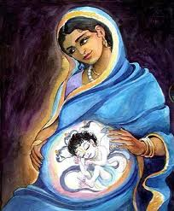
Developmentally Supportive Care
STRESS
Providing a structured care environment which supports, encourages and guides the developmental organization of the premature / critically ill infant.

Slide 8

Tactile
Stimulation
Over -stimulation
PAIN
Position - Prone
Nesting
Swaddling
Facilitated tuck
Massage

Slide 9
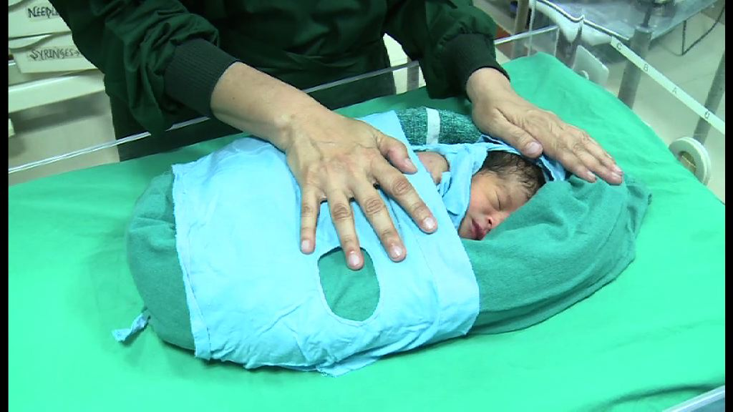
Tactile –
Swaddling, Facilitated Tuck
Pain
Development

Slide 10
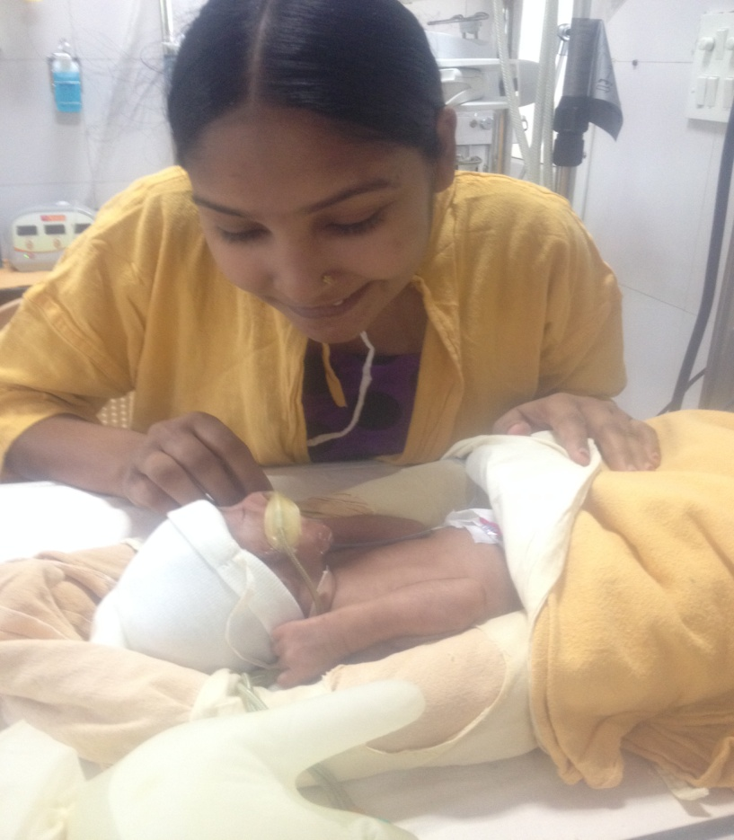
Tactile - Massage
Neurobehavior
Weight gain
Sleep
Pain, Stress
Hospital stay, Infection

Slide 11
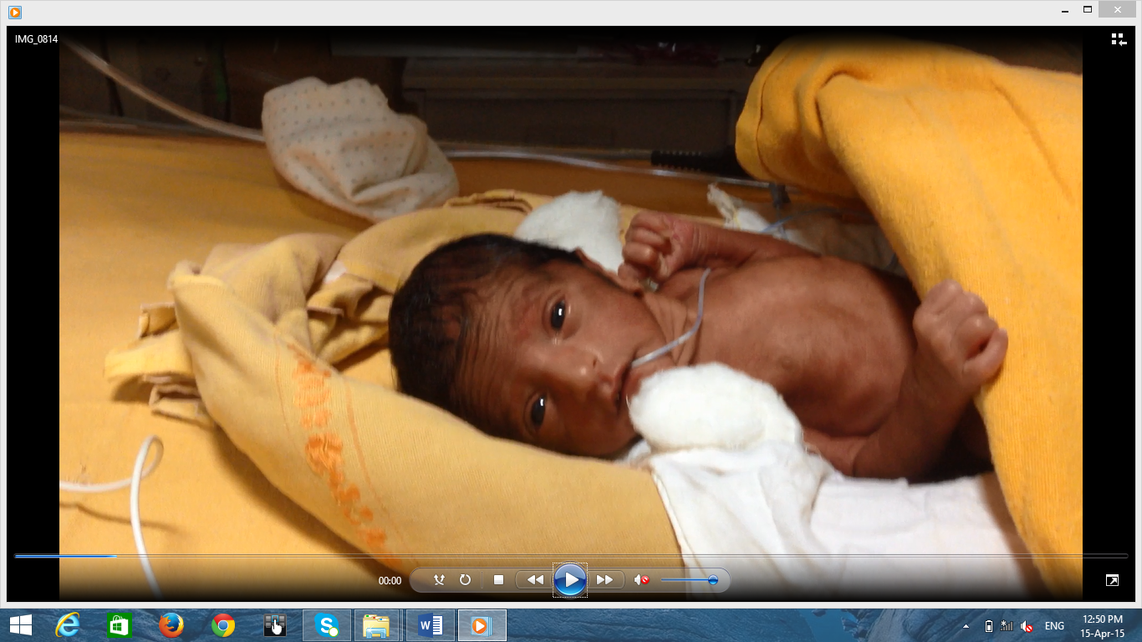
Does the newborn experience pain?
A newborn including a preterm FEELS, RESPONDS TO and REMEMBERS pain

Slide 12
Pr0tection from Pain
Newborns do experience pain
They express pain with various behavioural and physiological indicators.
Prevention/ minimisation of pain is possible.
Prevention of pain is more important than treatment of pain.

Slide 13
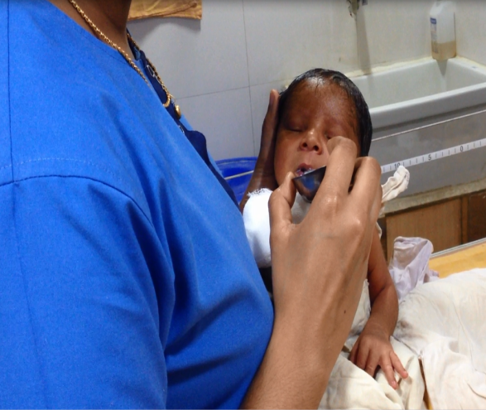
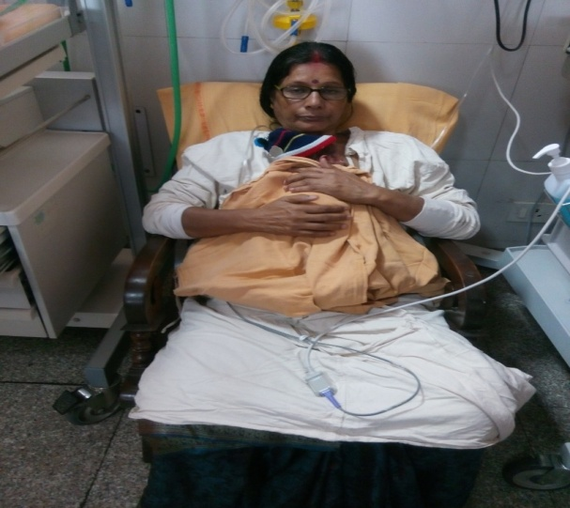
Smell and taste
  >32 wks
  Discriminate, remember, habituate
Expressed breast milk
Skin to skin Care

Slide 14
Non Nutritive Sucking
Kurian to insert picture of direct breast feeding
Length of hospital stay
Better feeding

Slide 15
Auditory
Noise is harmful
Stress
Reduces sleep
Hearing loss , IVH, PVL
Lower intelligence

Slide 16
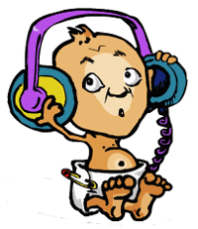
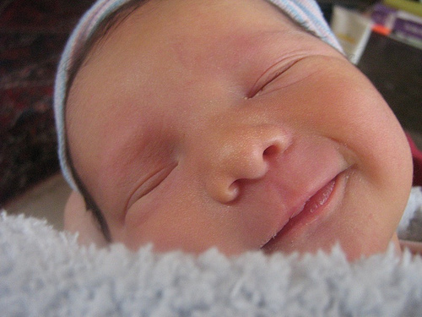
Auditory –
Protection from noise
Silence Please
Thank you for helping me sleep

Slide 17
Auditory – stimulation
Music therapy –
  Pacification
  Improves vital signs
  Feeding
  Sleep
Mother singing in a soft voice

Slide 18

Vision
Intense light - Interference with endogenous brain cell activity.
Sleep deprivation.
Healing environment
Avoid direct and intense light
Use point source for procedures
Adjustable light

Slide 19
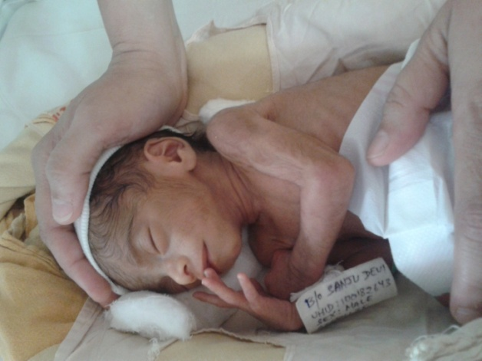
Protection of sleep
The activity occurring during REM sleep (or active sleep) seems to be particularly important to the developing organism
Deprivation of sleep ⇒ neuronal cell death & ⇓ brain mass
Provide a womb like environment

Slide 20
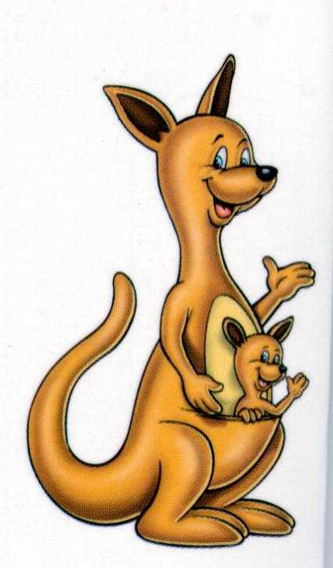
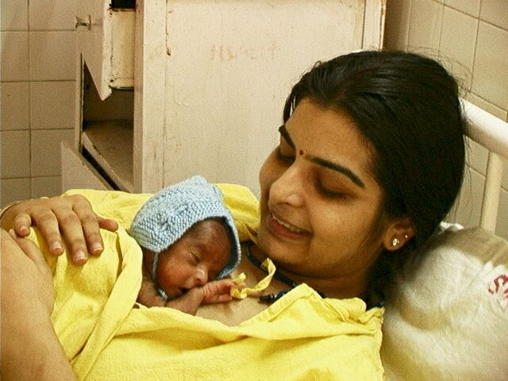
Kangaroo Mother Care
Baby’s Right, Mothers Delight

Slide 21
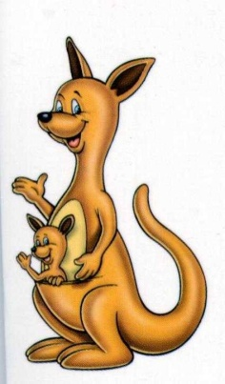
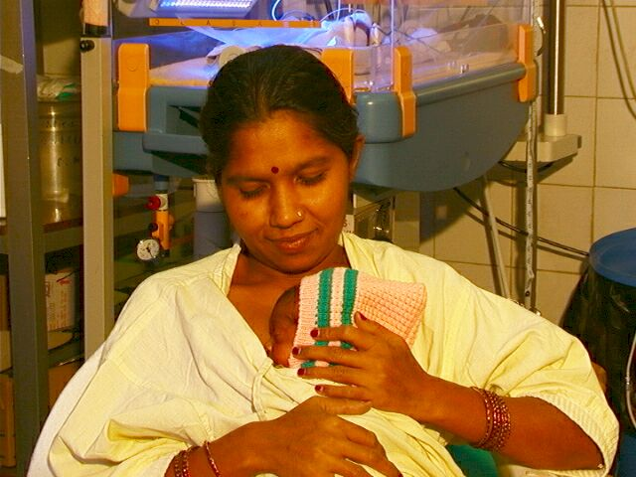
KMC – Best Developmentally supportive care !!!
.
Tactile
Visual
Vestibular
Auditory
Gustatory
Olfactory
Notes:
The exceptionality of kangaroo care is that it provides an appropriate balance between the under-stimulated tactile-proprioceptive system and the overwhelmed later-developing sensory modalities. The particular value of kangaroo care is its consistency with Gottlieb’s theory on the sequential development of the sensory system. This approach is also in accordance with Als and colleagues’ minimal handling program as it shields infants from the ongoing aversive stimulation of the nursery and its caretakers.

Slide 22
5 Core components of DSC
Pain protection
  Assessment
  Management -Physiological / behavioral
Developmentally supportive ADL
  Feeding
  NNS
  Nappy change
  Massage
Protected sleep
  Cluster care
  Nesting /Swaddling
  Environment
  KMC
Family centred care
  KMC
  Education & participation collaboration with family
Healing environment
  Noise
  Light
  Smell
  Positioning
  KMC

Slide 23
DSC
DSC is a continuous process and not an end.
It starts with the birth of the infant
The infants are unique and display wide variety of behaviors
DSC has to be individualized for the infant.

Slide 24
Key Messages
DSC – reduces stress and promotes growth.
Sequential stimulation of the senses
KMC is the best form of DSC
5 core components of DSC
It has to be individualized based on infants’ cues

Slide 25
Thank you

